Slide 1
CAPTCHA RECOGNITION
BY
GNIT AI/ML DYNAMIC STARTUP

Slide 2
OBJECTIVE
To propose an active deep learning
methodology that utilizes the capacity
to increase the accuracy in predicting the
CAPTCHAs and examine how to pick
the new examples to retrain the system
and present outcomes on an generated
CAPTCHA dataset.

Slide 3
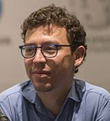
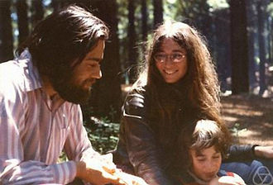
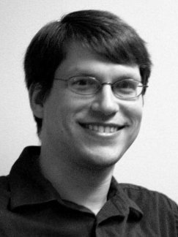
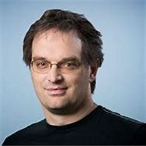
INTRODUCTION
C
A
P
T
C
H
A
Luis von Ahn
ompletely
utomated
ublic
uring test to tell
omputers and
umans
part
Manuel Blum
Nicholas J. Hopper
John Langford

Slide 4
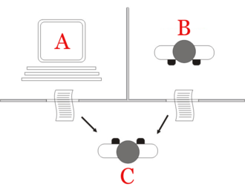
INTRODUCTION
REVERSE TURING TEST
TURING TEST
A
B
C
The "standard interpretation" of the Turing test, in which player C, the interrogator, is given the task of trying to determine which player – A or B – is a computer and which is a human.
A reverse Turing test is a Turing test in which the objective or roles between computers and humans have been reversed.

Slide 5
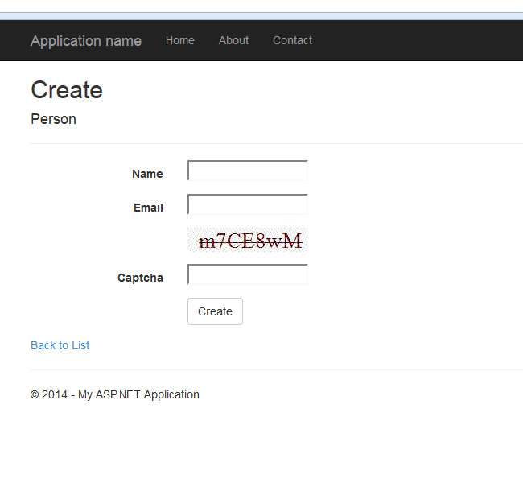
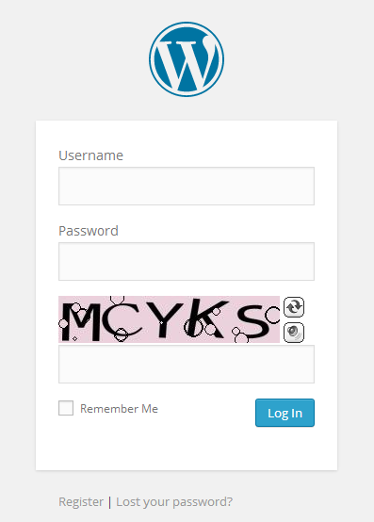
INTRODUCTION
m7CE8wM
MCYKS

Slide 6
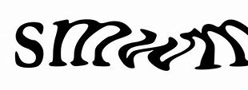
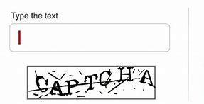

Problem Statement
Though Captchas play the most relevant role in preventing machines from accessing the internet , there are specific limitations which makes them more annoying.
The cons--
-Annoyance
-Illegible
-Vision
-Traffic

Slide 7
SOLUTION
The mentioned drawbacks of Captchas are considerable and there must be a way to overcome the drawbacks. This can be done by bypassing the Captcha.
CAPTCHA BYPASS is an automated process where the captcha can be solved automatically with less human interference.
Now there are various methods to bypass different types of Captchas, among which we have dealt with two of them.
-Optical Character Recognition(Tesseract OCR)
-Convolution Neural Networks(CNN)

Slide 8
Tesseract OCR
Optical Character Recognition (OCR) is the process of electronically extracting text from images. Tesseract, is an open-source OCR engine maintained by Google, to grab text from images.
Tesseract’s Limitations
Tesseract OCR is quite powerful, but does have the following limitations:
Tesseract isn’t trained to recognize handwriting, and it’s limited to about 100 fonts in total.
Tesseract requires a bit of pre-processing to improve the OCR results: Images need to be scaled appropriately, have as much image contrast as possible, and the text must be horizontally aligned.
Finally, Tesseract OCR only works on Linux, Windows and Mac OS X.

Slide 9
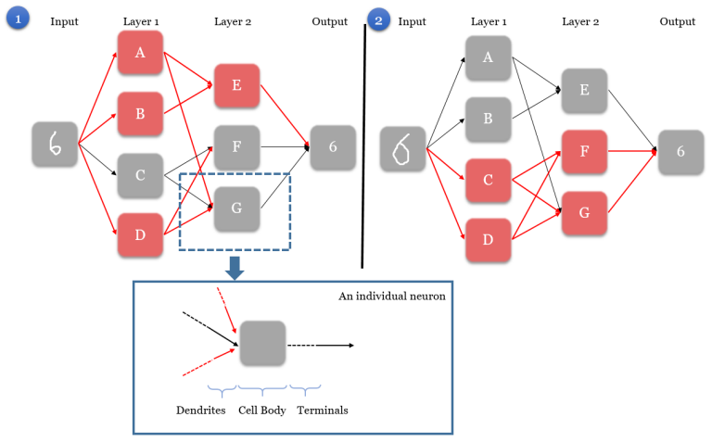
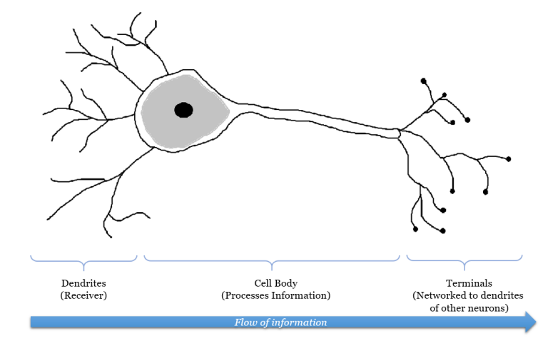
The Neurons that Inspired the Network
CONVOLUTION
(ARTIFICIAL)
NEURAL
NETWORKS
A simple Artificial Neural Network map, showing two scenarios with two different inputs but with the same output. Activated neurons along the path are shown in red.

Slide 10
Architecture of the prototype
Yes
No
Captcha Bypass
Web Scraping
Captcha appears
Image to text(CNN)
Enter Manually
Paste Captcha

Slide 11

METHODOLOGY
Web Scraping
Web scraping is a technique for extracting information from the internet automatically using software that simulates human web surfing.
It is a suite of tools to automate web browsers across many platforms.
Selenium
BeautifulSoup is a third party Python library and is designed for quick turnaround projects like screen-scraping. Beautiful Soup parses anything you give it.
BeautifulSoup

Slide 12
METHODOLOGY
Image to Text(CNN)
After web scraping the captcha image, the image is converted into text. The following are the modules used in python to run the Neural Network code:
Open CV
OpenCV-Python is a library of Python bindings designed to solve computer vision problems. OpenCV-Python makes use of Numpy.
Keras is a minimalist Python library for deep learning that can run on top of TensorFlow.
Keras
TensorFlow is a Python library for fast numerical computing created and released by Google.
TensorFlow

Slide 13
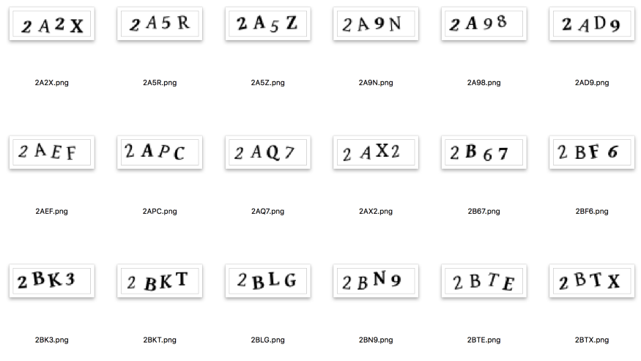
METHODOLOGY
The following are the steps involved in converting the captcha image into text:
STEP 1 : Creating our Dataset
To train any machine learning system,
we need training data. To break a
CAPTCHA system, we want training
data that looks like this:

Slide 14
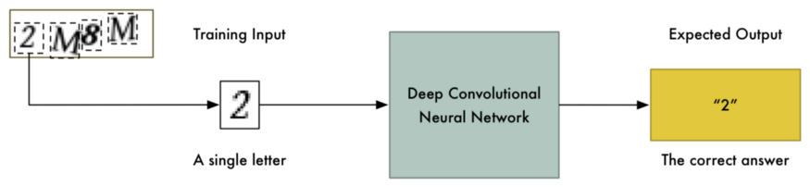
METHODOLOGY
STEP 2 : Simplifying the Problem
The simpler the problem, the less training data and the less computational power we’ll need to solve it.

Slide 15
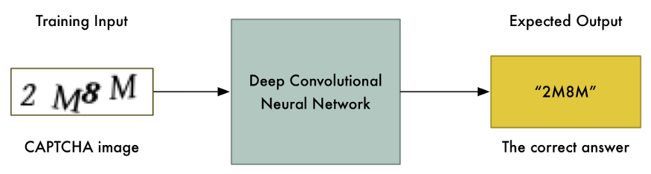
METHODOLOGY
STEP 3 : Building and Training the Neural Network
Since we only need to recognize images of single letters and numbers, we
don’t need a very complex Neural Network architecture.

Slide 16
METHODOLOGY
STEP 4 : Using the Trained Model to Solve CAPTCHAs
Now that we have a trained neural network, using it to break
a real CAPTCHA is pretty simple.

Slide 17

The obtained text captcha is then pasted in the required text field :
Do you want to enter the captcha automatically?
Yes
No
7KMB
enter captcha

Slide 18
CONCLUSION
Degrading images by adding noise and breaking characters makes it more difficult, but not impossible, to solve CAPTCHAs with Convolution Neural Networks.
However, making something harder for a computer to recognize also makes it harder for humans.
Hence implementing Captcha Bypass is a more reliable method.

Slide 19
THANK YOU

